Slide 1
future sales prediction

Slide 2
Dataset Description
date – date in format dd/mm/yyyy
shop_id – unique identifier of a shop
item_id – unique identifier of a product
item_price – the current price of an item
item_cnt_day – number of products sold per day

Slide 3
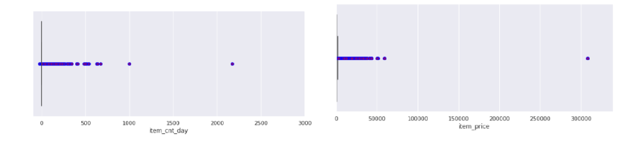
Data Cleaning

Slide 4
Data cleaning is an essential step in preparing your data for future sales prediction or any data analysis task. Clean data ensures that your predictions are accurate and reliable. Here are some common data cleaning steps you should consider:
.
Data Transformation:
Convert data types if necessary. For example, ensure that date fields are in a consistent date format and numerical fields are in the correct format.

Slide 5
Data Set
1 tv radio newspaper sales
2 230.1 37.8 69.2 22.1
3 44.5 39.3 45.1 12
4 17.2 45.9 69.3 12
5 151.5 41.3 58.5 16.5
6 180.8 10.8 58.4 17.9
7 8.7 48.9 75 7.2
8 57.5 32.8 23.5 11.8

Slide 6
Program
import datetime
import warnings
import numpy as np
import pandas as pd
import seaborn as sns
import matplotlib.pyplot as plt
import mglearn
from sklearn.preprocessing import MinMaxScaler
from sklearn.linear_model import LinearRegression
from sklearn.metrics import mean_squared_error, r2_score
from sklearn.model_selection import cross_val_score
from sklearn.model_selection import KFold
from sklearn.model_selection import GridSearchCV
from sklearn.linear_model import Ridge
from sklearn.linear_model import Lasso
from sklearn.preprocessing import PolynomialFeatures
from sklearn.neighbors import KNeighborsRegressor
from sklearn.linear_model import SGDRegressor
from sklearn.tree import DecisionTreeRegressor
from sklearn.ensemble import RandomForestRegressor
from xgboost import XGBRegressor

Slide 7
item_categories = pd.read_csv('../Data/item_categories.csv',
dtype={'item_category_name': 'str', 'item_category_id': 'int32'})
items = pd.read_csv('../Data/items.csv', dtype={'item_name': 'str', 'item_id': 'int32',
'item_category_id': 'int32'})
sales_train = pd.read_csv('../Data/sales_train_v2.csv', parse_dates=['date'],
dtype={'date': 'str', 'date_block_num': 'int32', 'shop_id': 'int32',
'item_id': 'int32', 'item_price': 'float32', 'item_cnt_day': 'int32'})
shops = pd.read_csv('../Data/shops.csv', dtype={'shop_name': 'str', 'shop_id': 'int32'})
test = pd.read_csv('../Data/test.csv', dtype={'ID': 'int32', 'shop_id': 'int32',
'item_id': 'int32'})

Slide 8
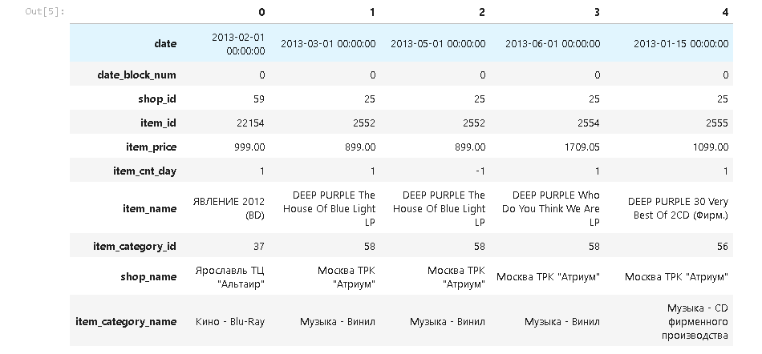
train = sales_train.join(items, on='item_id', rsuffix='_').join(shops, on='shop_id', rsuffix='_').join(item_categories, on='item_category_id', rsuffix='_').drop(['item_id_', 'shop_id_', 'item_category_id_'],
axis=1)
train.shape
(2935849, 10)
train.head().T

Slide 9
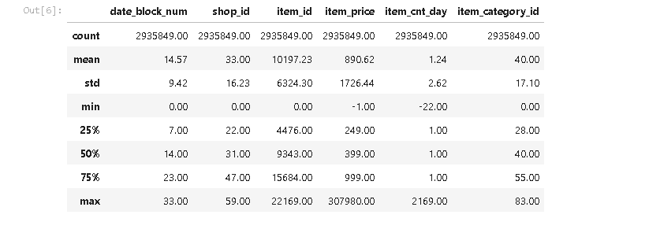
train.describe()

Slide 10
train = train[['date','date_block_num', 'shop_id', 'item_id', 'item_price', 'item_cnt_day',
'item_category_id']]
train_monthly = train.sort_values('date').groupby(['date_block_num', 'shop_id', \
'item_category_id', 'item_id'], as_index=False)
train_monthly = train_monthly.agg({'item_price':['sum', 'mean'],
'item_cnt_day':['sum', 'mean','count']})
train_monthly.columns = ['date_block_num', 'shop_id', 'item_category_id',
'item_id', 'item_price', 'mean_item_price', 'item_cnt',
'mean_item_cnt', 'transactions']
shopid_test = test['shop_id'].unique()
itemid_test = test['item_id'].unique()
train_monthly = train_monthly[train_monthly['shop_id'].isin(shopid_test)]
train_monthly = train_monthly[train_monthly['item_id'].isin(itemid_test)]

Slide 11
train_monthly['year'] = train_monthly['date_block_num'].apply(lambda x: ((x//12) + 2013))
train_monthly['month'] = train_monthly['date_block_num'].apply(lambda x: (x % 12))
month_item_cnt_sum = train_monthly.groupby(['month'], as_index=False)['item_cnt'].sum()
month_item_cnt_mean = train_monthly.groupby(['month'], as_index=False)['item_cnt'].mean()
plt.figure(figsize=(36,10))
sns.lineplot(x="month", y="item_cnt", data=month_item_cnt_sum).set_title("Monthly Total Sales")
plt.show()

Slide 12
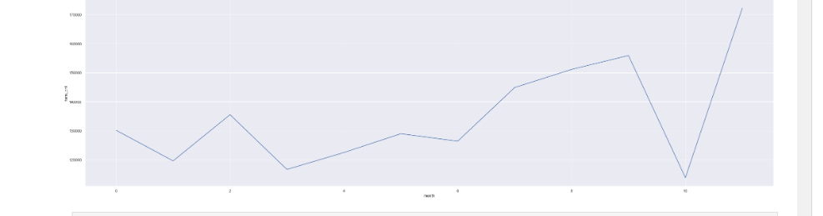
plt.figure(figsize=(36,10))
sns.lineplot(x="month", y="item_cnt", data=month_item_cnt_mean).set_title("Monthly Mean Sales")
plt.show()

Slide 13
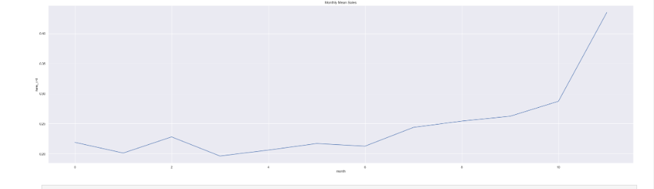
shop_item_cnt_sum = train_monthly.groupby(['shop_id'], as_index=False)['item_cnt'].sum()
shop_item_cnt_mean = train_monthly.groupby(['shop_id'], as_index=False)['item_cnt'].mean()
plt.figure(figsize=(15,10))
sns.barplot(x="shop_id", y="item_cnt", data=shop_item_cnt_sum, palette="rocket").set_title("Monthly Total Sales by Shop ID")
plt.show()

Slide 14
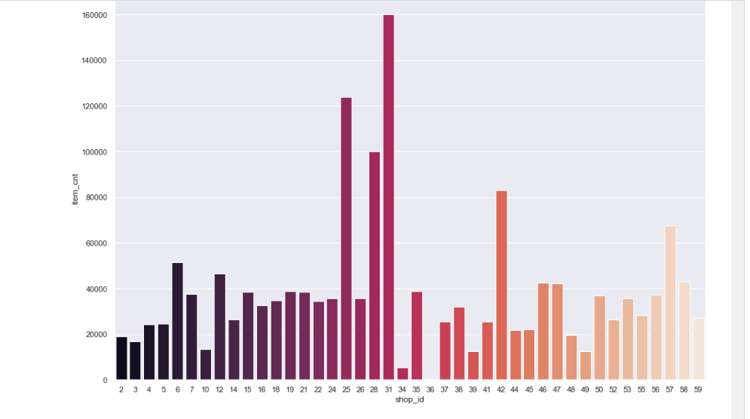

Slide 15
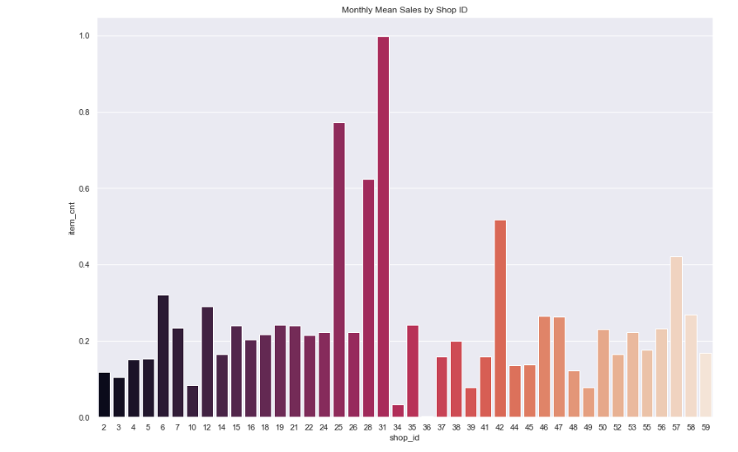
plt.figure(figsize=(15,10))
sns.barplot(x="shop_id", y="item_cnt", data=shop_item_cnt_mean, palette="rocket").set_title("Monthly Mean Sales by Shop ID")
plt.show()

Slide 16
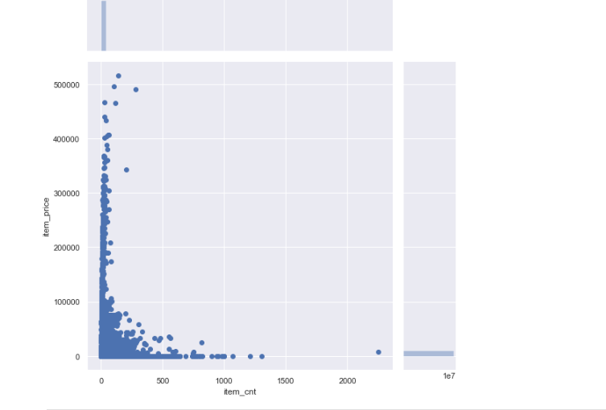
sns.jointplot(x="item_cnt", y="item_price", data=train_monthly, height=8)
plt.show()

